Slide 1
OpenChain Monthly Meeting
2022-10-18

Slide 2
Anti-Trust Policy Notice
Linux Foundation meetings involve participation by industry competitors, and it is the intention of the Linux Foundation to conduct all of its activities in accordance with applicable antitrust and competition laws. It is therefore extremely important that attendees adhere to meeting agendas, and be aware of, and not participate in, any activities that are prohibited under applicable US state, federal or foreign antitrust and competition laws.
Examples of types of actions that are prohibited at Linux Foundation meetings and in connection with Linux Foundation activities are described in the Linux Foundation Antitrust Policy available at http://www.linuxfoundation.org/antitrust-policy. If you have questions about these matters, please contact your company counsel, or if you are a member of the Linux Foundation, feel free to contact Andrew Updegrove of the firm of Gesmer Updegrove LLP, which provides legal counsel to the Linux Foundation.

Slide 3
Regular Agenda
Introductions
Specification news
SBOM news
OSPO news
Automation news
Work on standards and core material
Work on reference and supporting material
Work to support other projects
Any other business
Close of meeting

Slide 4
Introductions

Slide 5
Specification news

Slide 6
OpenChain Security Assurance Release
Our new Security Assurance Specification:
https://www.openchainproject.org/news/2022/10/04/the-openchain-security-assurance-specification-1-1-now-available
Access it on GitHub:
https://github.com/OpenChain-Project/Security-Assurance-Specification/blob/main/Security-Assurance-Specification/1.1/en/openchain-security-specification-1.1.md

Slide 7
Self-Certification Material Refresh
New self-certification materials:
https://www.openchainproject.org/news/2022/10/05/preparing-next-gen-openchain-self-certification-questionnaire-and-checklist
Self-certification checklist for ISO/IEC 5230 example:
https://github.com/OpenChain-Project/Reference-Material/blob/master/Self-Certification/Checklist/ISO5230-2020/en/OpenChain%20Self-Certification%20Checklist%202022-10-05.md

Slide 8
OpenChain Security Assurance Self-Certification
Self-Certification Checklist available in English
https://github.com/OpenChain-Project/Reference-Material/blob/master/Self-Certification/Checklist/Security-Assurance-1.1/en/Security-Assurance-1-1-Checklist-Version-2.md
Self-Certification Checklist available in Simplified Chinese
https://github.com/OpenChain-Project/Reference-Material/blob/master/Self-Certification/Checklist/Security-Assurance-1.1/zh-Hans/Security-Assurance-1-1-Checklist-Version-2.md

Slide 9
SBOM news

Slide 10
SPDX Project is looking for supporters
If you use or help contribute to SPDX ISO/IEC 5962:2021, the project would be happy to list you as a support on their main website. There is no cost involved. Check out the current list:
https://spdx.dev

Slide 11
OSPO news

Slide 12
Event in Sweden 19th and 20th October 2022
https://community.linuxfoundation.org/events/details/lfhq-todo-group-europe-presents-ospologylive-workshop-sweden/

Slide 13
Automation news

Slide 14
Regular meetings open for all
New Reference Tooling meeting schedule (bi-weekly):
https://www.openchainproject.org/news/2022/10/03/openchain-reference-tooling-work-group-meetings-new-regular-schedule

Slide 15
Other news

Slide 16
Improved Work Group activities
Our new Monthly Community Call schedule:
https://www.openchainproject.org/featured/2022/10/06/monthly-community-call-2022-10-04
Our new Work Group structure:
https://www.openchainproject.org/news/2022/10/12/wg-structure

Slide 18
Work Group Activity in Q4 Announced So Far
New Telco meeting schedule (monthly):
https://www.openchainproject.org/news/2022/10/13/telco-work-group-meetings-new-regular-schedule
Automotive Work Group Meeting:
https://www.openchainproject.org/news/2022/10/12/automotive-wg-meeting-2022-11-11
Japan Work Group meeting:
https://www.openchainproject.org/news/2022/10/06/japan-wg-25
Germany Work Group meeting:
https://www.openchainproject.org/featured/2022/09/29/germany-wg-2022-11-16

Slide 19
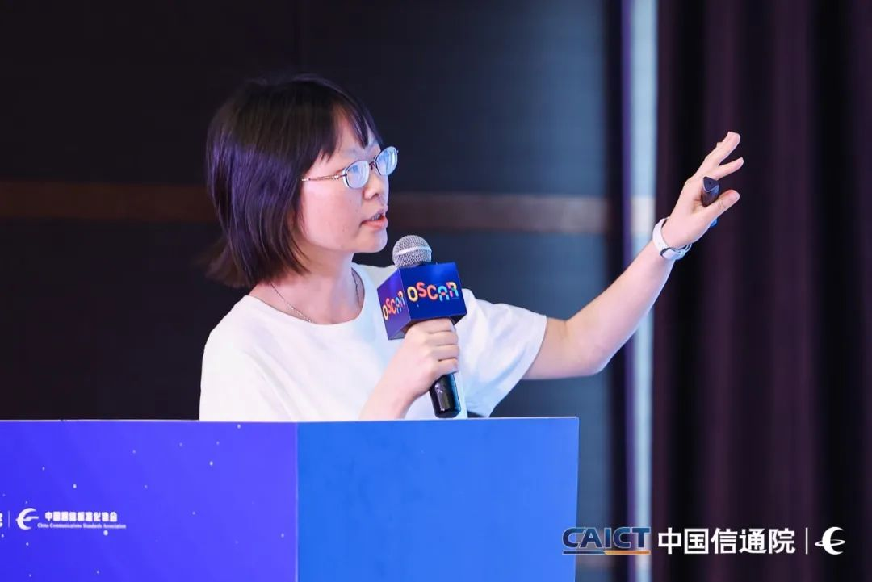
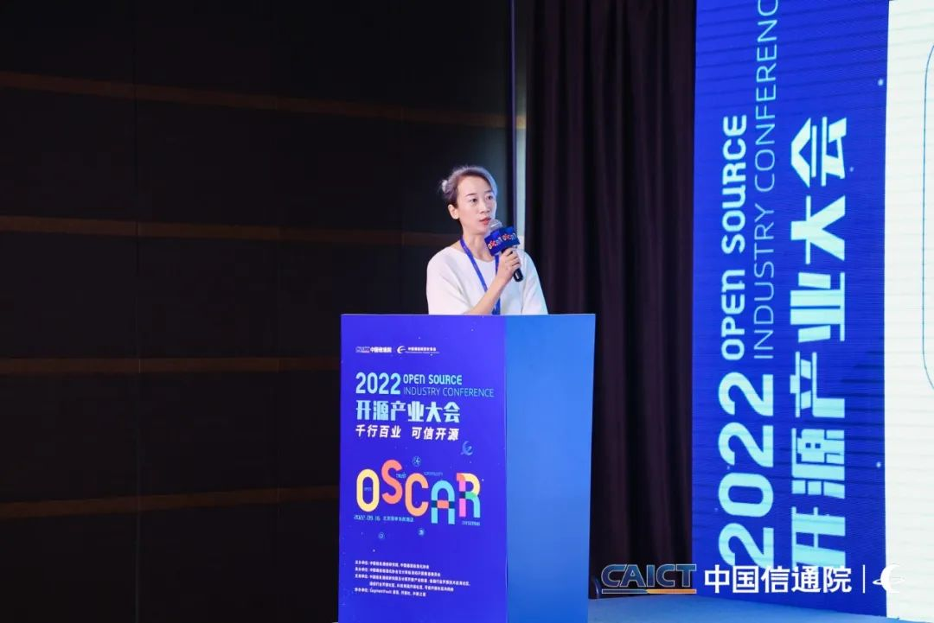
OSCAR Event in China with CAICT + OpenAtom
https://www.openchainproject.org/news/2022/10/12/oscar-2022-report

Slide 20
Partner program continues to grow
Witzel Erb Backu & Partner, a law firm founded in 2020 by alumni of the Munich law firm SSW Schneider Schiffer Weihermüller, has joined the OpenChain Partner Program.
https://www.openchainproject.org/news/2022/10/14/witzel-erb-backu

Slide 21
Work on standards and core material

Slide 22
Let’s start on Security Assurance 2.0 – ETA 2023
The specification is on GitHub here:
https://github.com/OpenChain-Project/Security-Assurance-Specification
Review and open issues with suggestions for improvement:
https://github.com/OpenChain-Project/Security-Assurance-Specification/issues
We will be editing the next version of the specification on these calls moving forward.

Slide 23
Let’s start on License Compliance 3.0 – ETA 2024
The OpenChain (licensing compliance) specification 2.1 is on GitHub here:
https://github.com/OpenChain-Project/License-Compliance-Specification
Review and open issues with suggestions for improvement:
https://github.com/OpenChain-Project/License-Compliance-Specification/issues
We will be editing the next version of the specification on these calls moving forward.

Slide 24
Work on reference and supporting material

Slide 25
Making it easier to create and update material
Huge project to update our reference material to easier to edit formats:
https://www.openchainproject.org/news/2022/10/05/call-to-action-markdown-ends
Example is the new self-certification material:
https://www.openchainproject.org/news/2022/10/05/preparing-next-gen-openchain-self-certification-questionnaire-and-checklist

Slide 26
Progress around Playbooks
New Small Company playbook (suitable for all company sizes):
https://www.openchainproject.org/news/2022/10/04/small-company-playbook-v1
We need to review and update Medium Company + create Large Company playbooks moving forward:
https://github.com/OpenChain-Project/Reference-Material/tree/master/PlayBooks/Official/Version-1/Medium-Company/en

Slide 27
Call for support
We are looking for contributions to help make more material in the reference library easier to edit and easier to translate.
Our Education Work Group will be using these calls from November for live editing of key material.
You can also track material and contribute via GitHub:
https://github.com/OpenChain-Project/Reference-Material

Slide 28
Work to support other projects

Slide 29
Events coming up
Our next big event is Open Compliance Summit, December 7th and 8th in Yokohama, Japan
This event will cover license, security and export control compliance
We also expect to host OpenChain, TODO and SPDX Mini-Summit adjacent
Learn more: https://events.linuxfoundation.org/open-compliance-summit/

Slide 30
Any other business

Slide 31
New templates to help you
Meeting and Presentation slide template:
https://github.com/OpenChain-Project/Reference-Material/tree/master/Meeting-and-Presentation-Slide-Template/Official/en

Slide 32
Close of meeting

Slide 33
See you next time!

